Slide 1
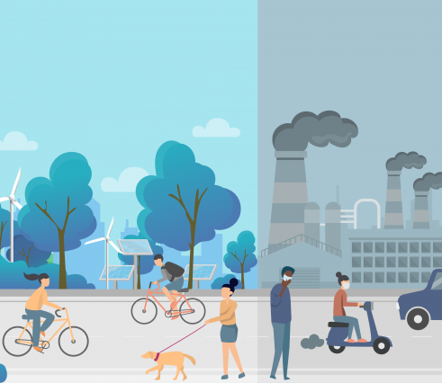
2024 U.S. Air-Quality Snapshot
Ali Nizar
Telmen Enkhtuvshin
CS 445 Stage 3

Slide 2
Purpose
Understand Air Quality Across the contiguous USA and other areas
1
Observe what the major pollutants are
2
Assess what the effect of each pollutants are
3

Slide 3

Scope
Used the latest 2024 data in the official EPA website.

Slide 4
Dataset Preview
NO2
NO2
SO2
CO
O3
AQI
PM Small Particulates
Location
Amount
O3
SO2
AQI
CO
PM

Slide 5
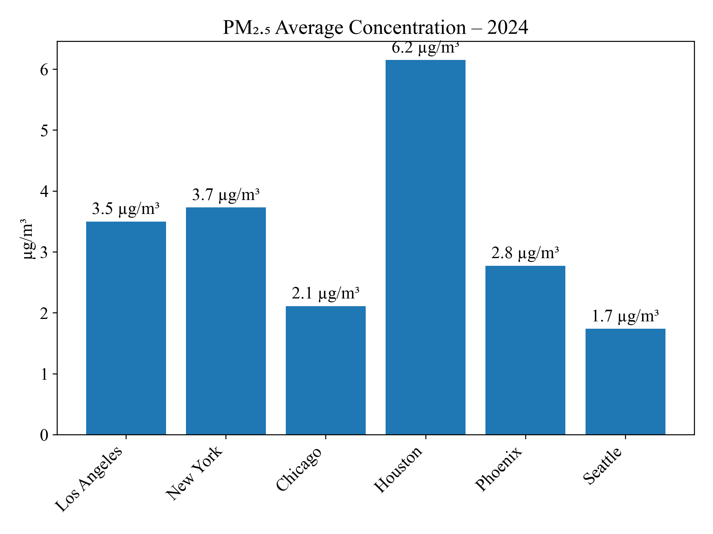
PM\u2082.₅ – Six Major Cities (2024)
Seattle posts the cleanest air at 1.7 µg/m³ while Houston tops the chart at 6.2 µg/m³. Even within a single year, particulate levels vary more than three-fold across major metros.

Slide 6
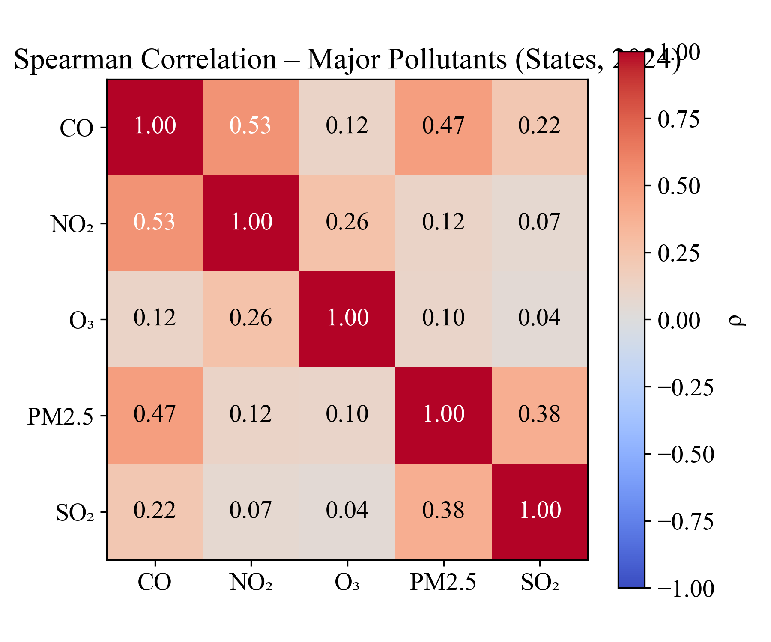
Spearman Correlation – Major Pollutants (States, 2024)
Traffic-related pollutants CO, NO₂, and PM remain strongly linked across states (ρ≈0.5). SO₂ correlates weakly, reflecting its more stationary-source origins."

Slide 7
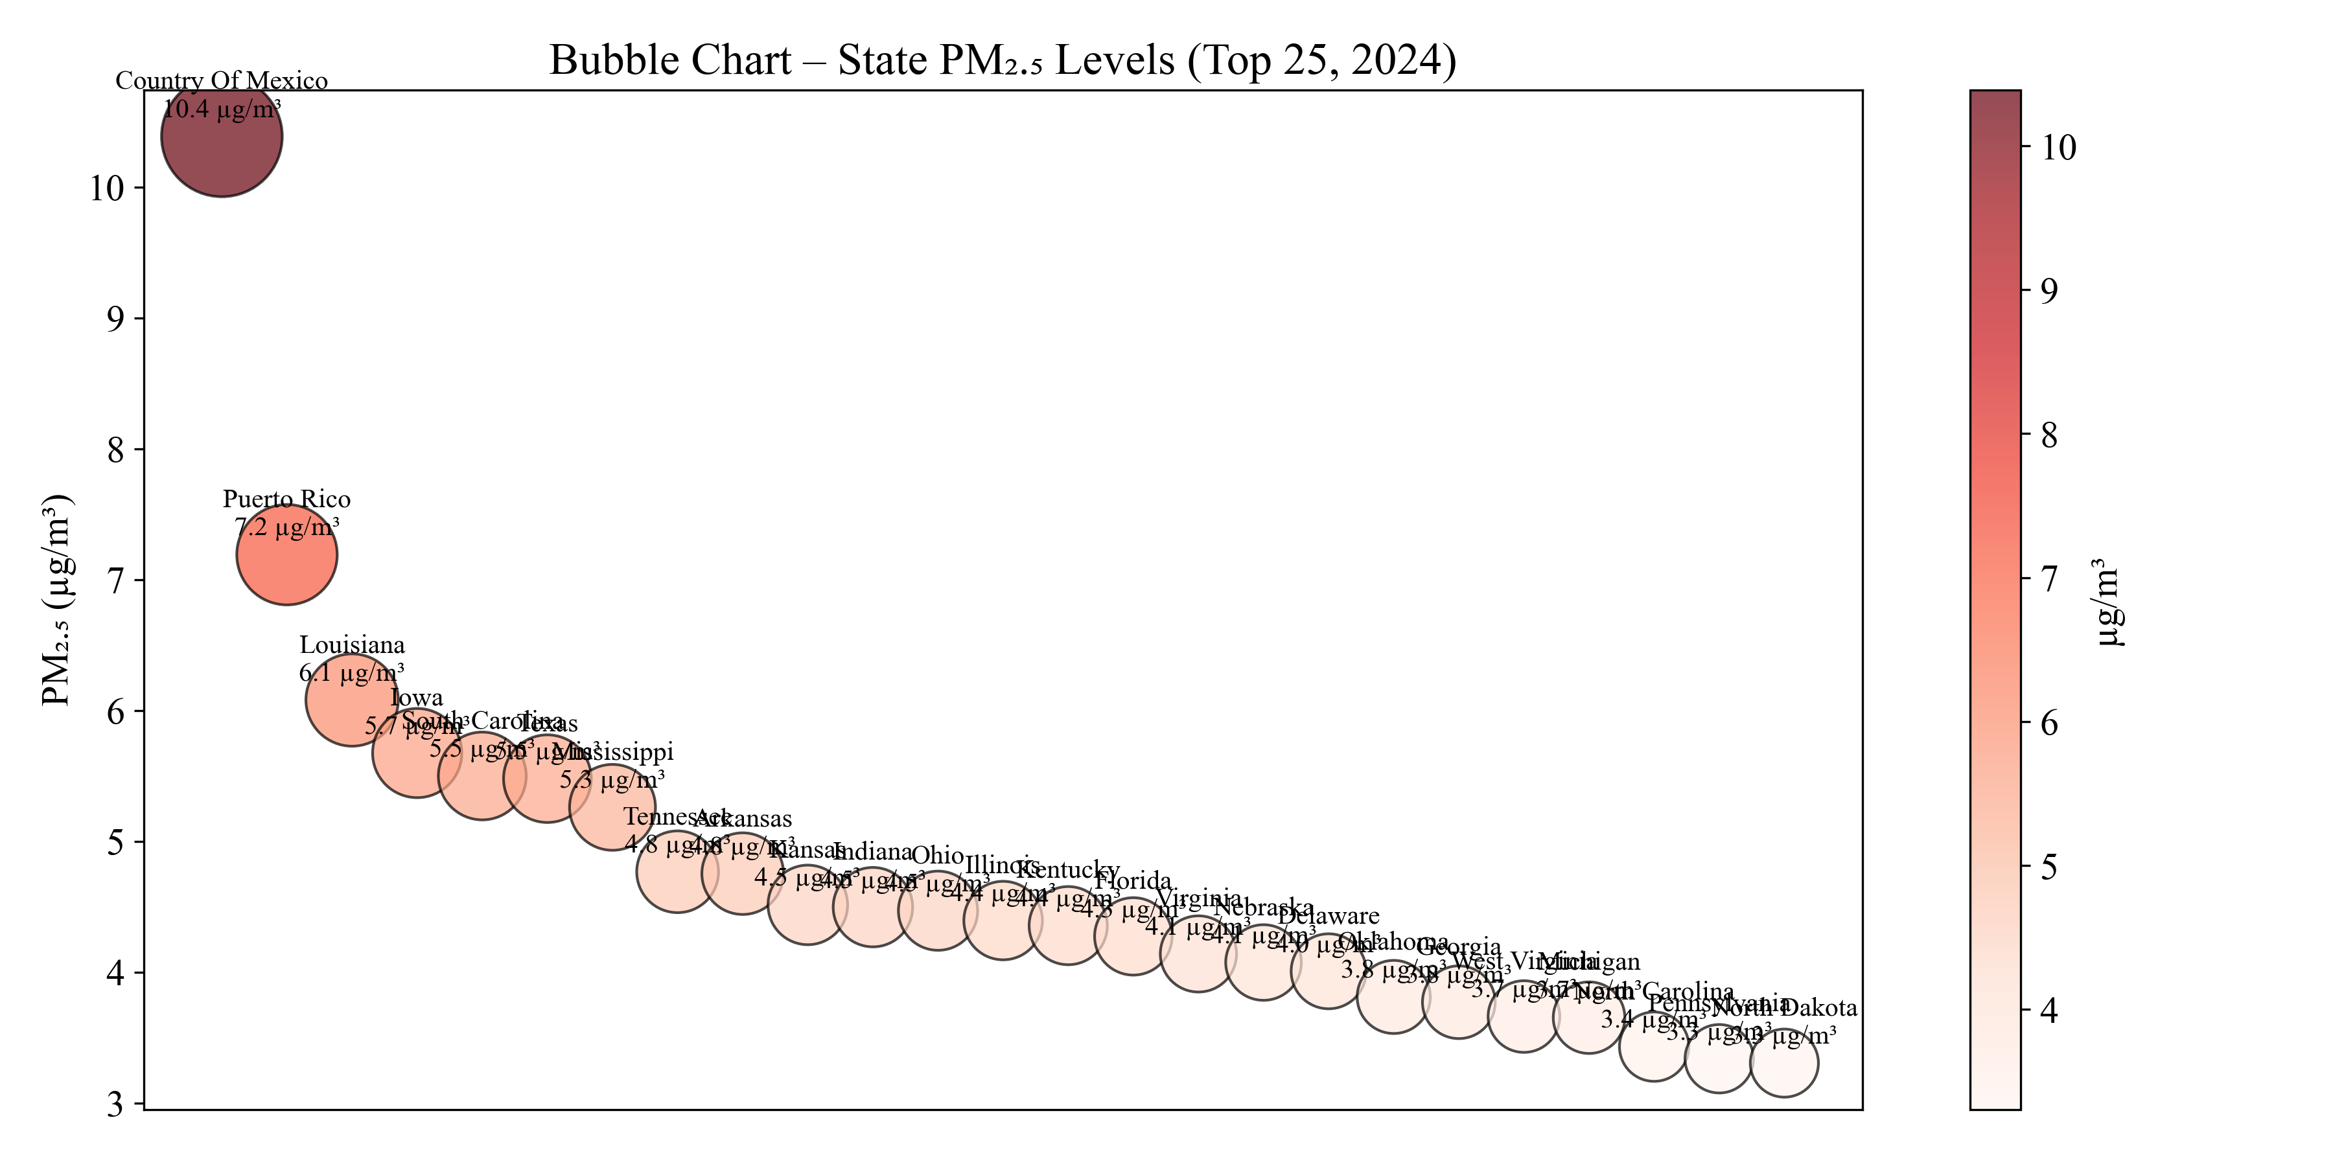
PM\u2082.₅ Hot-Spots – Bubble View (Top 25, 2024)
A handful of jurisdictions—led by “County of Mexico” and Puerto Rico—drive a disproportionate share of PM\u2082.₅ burden; most states cluster below 6 µg/m³.

Slide 8
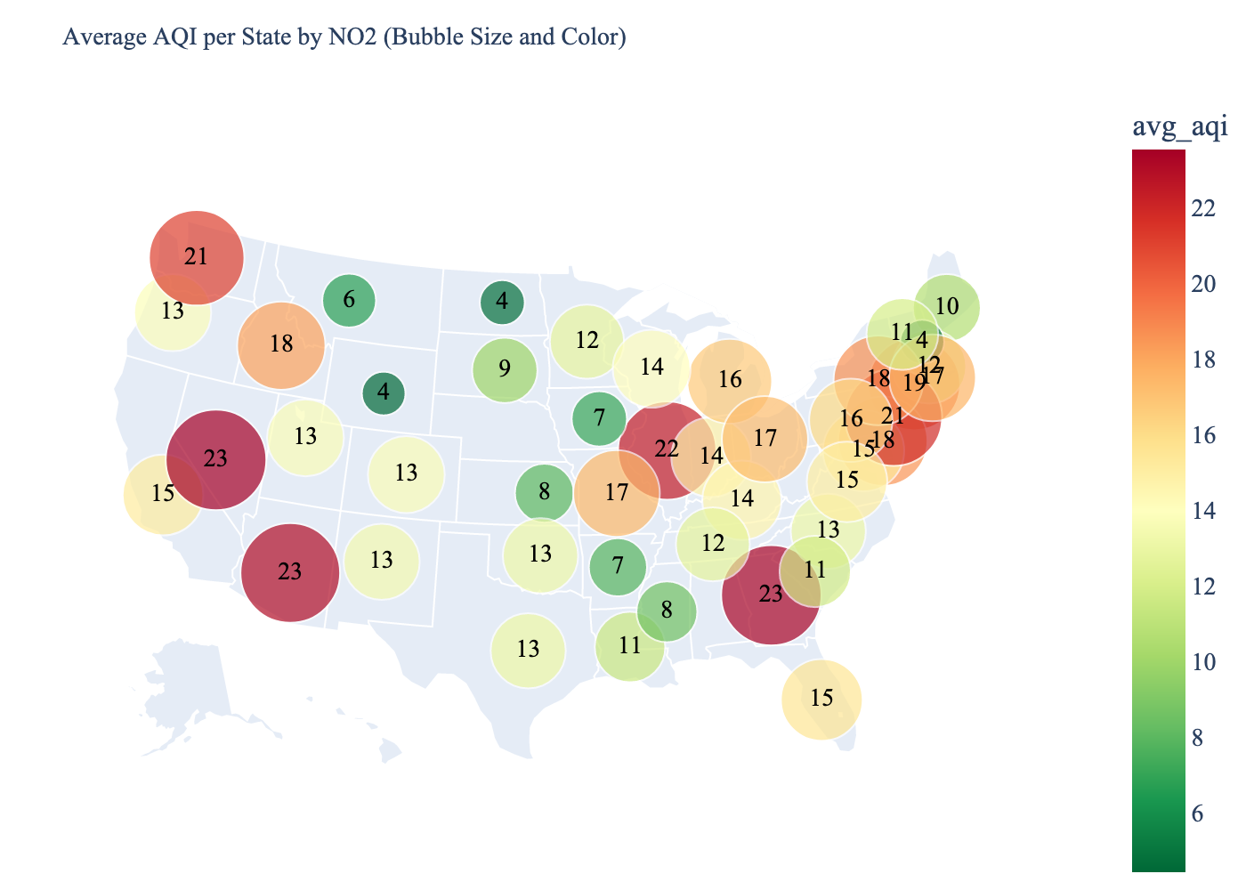
Average AQI Across the State from Nitrogen Dioxide (NO2), (2024)
The highest concentration of NO2 are in East and West coast of the mainland USA.
Concentrated in states with large population and big cities.

Slide 9
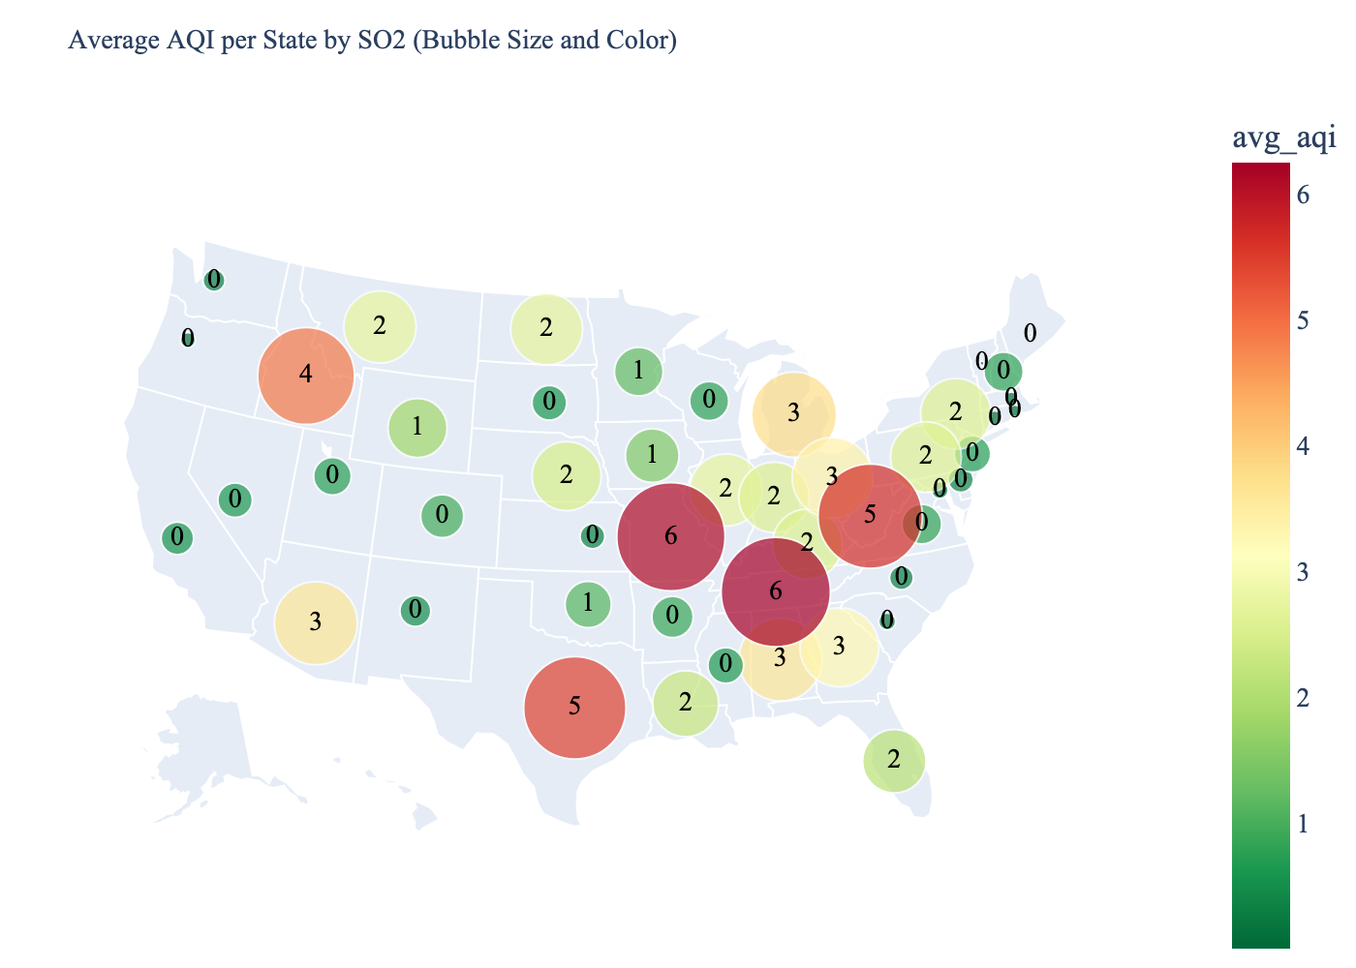
Average AQI Across the State from Sulfur Dioxide (SO2), (2024)
The highest concentration of SO2 are in Mid Eastern and Southern states.
Significant states clustered in East side.

Slide 10
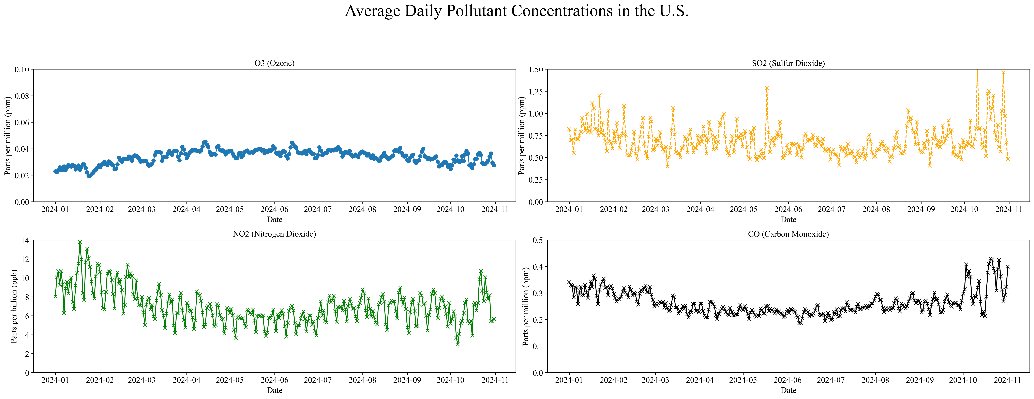
Chemical Pollutants Change
Shows 4 different chemical pollutant amount change

Slide 11
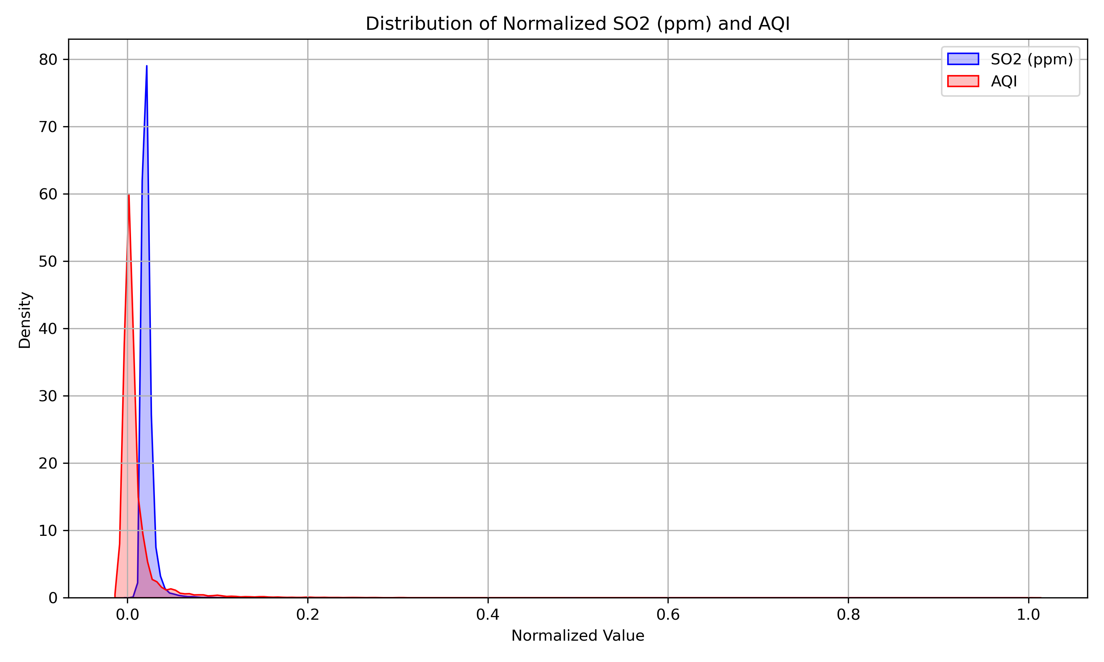
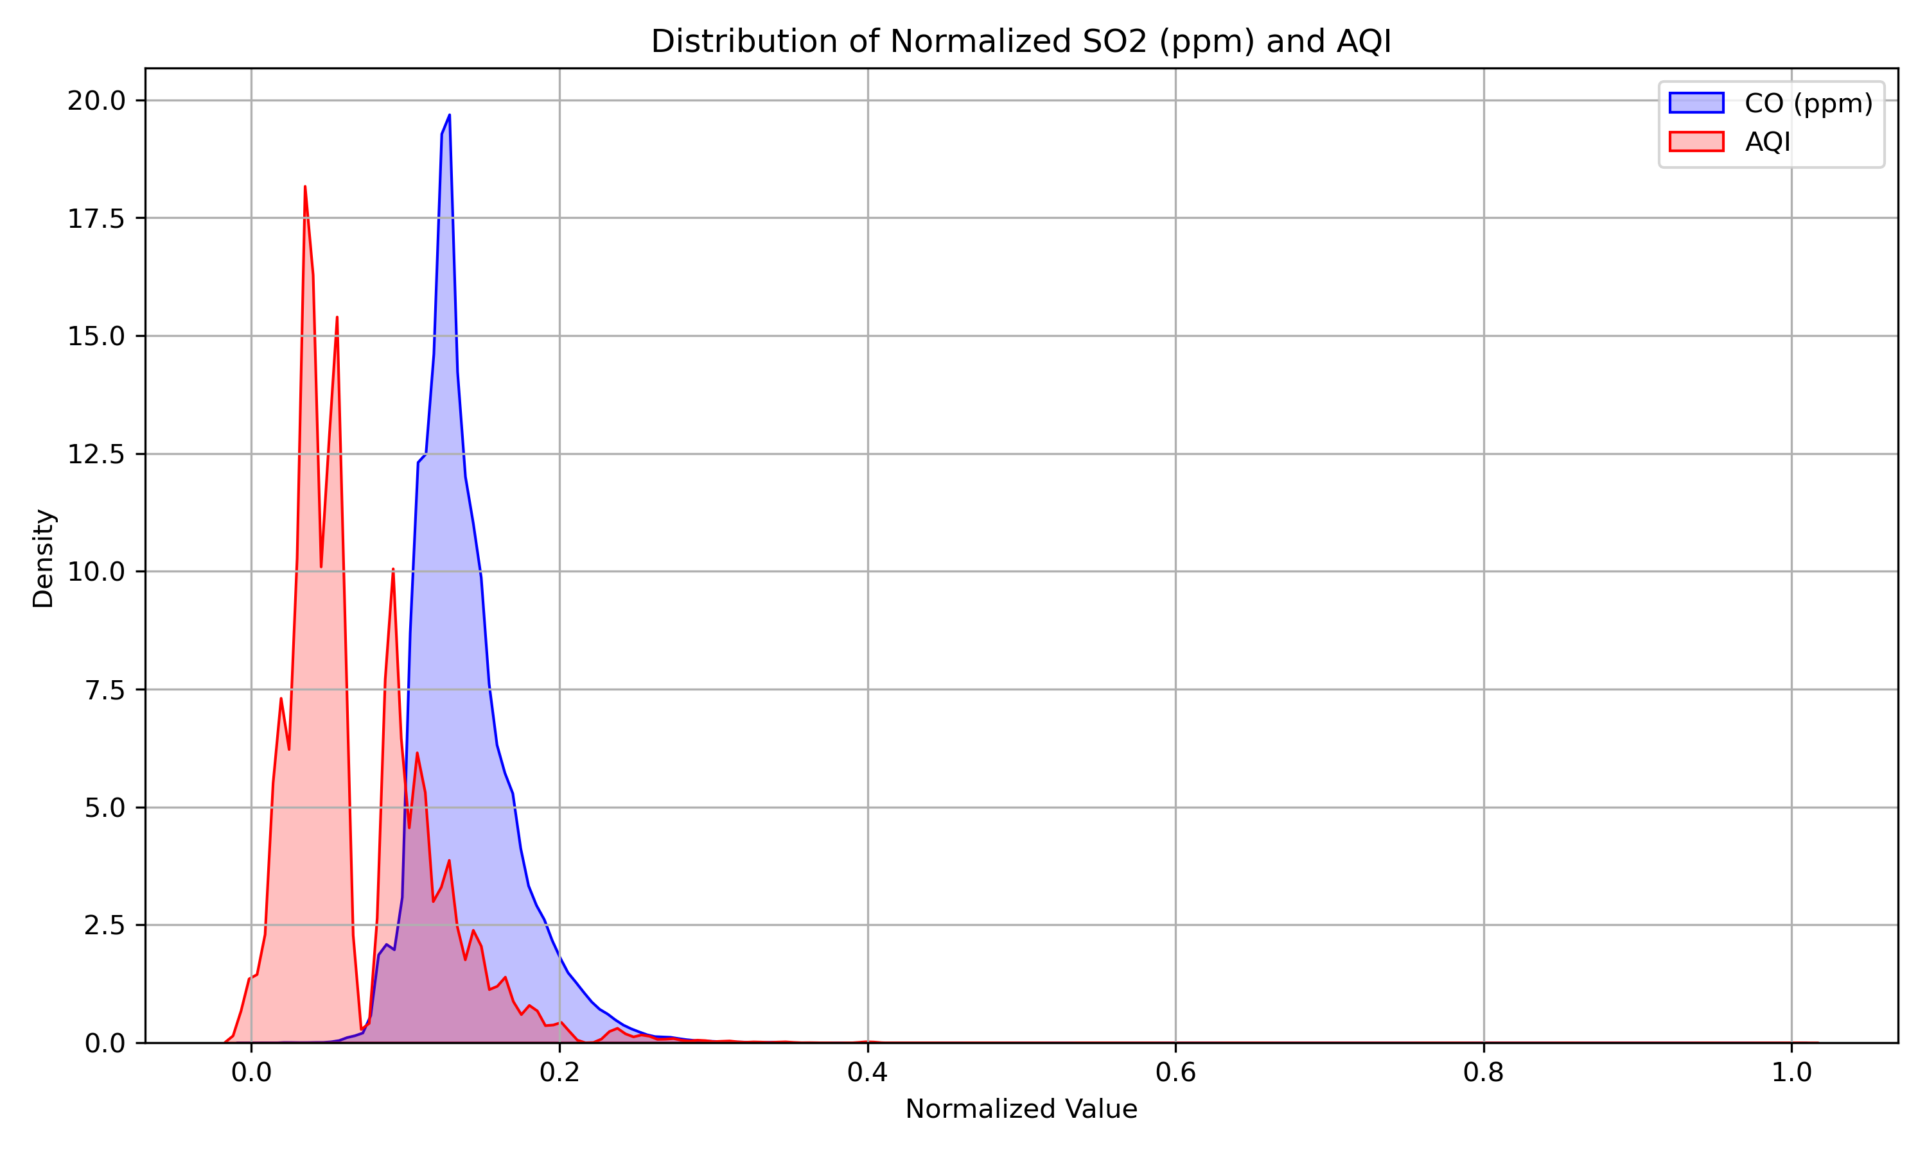
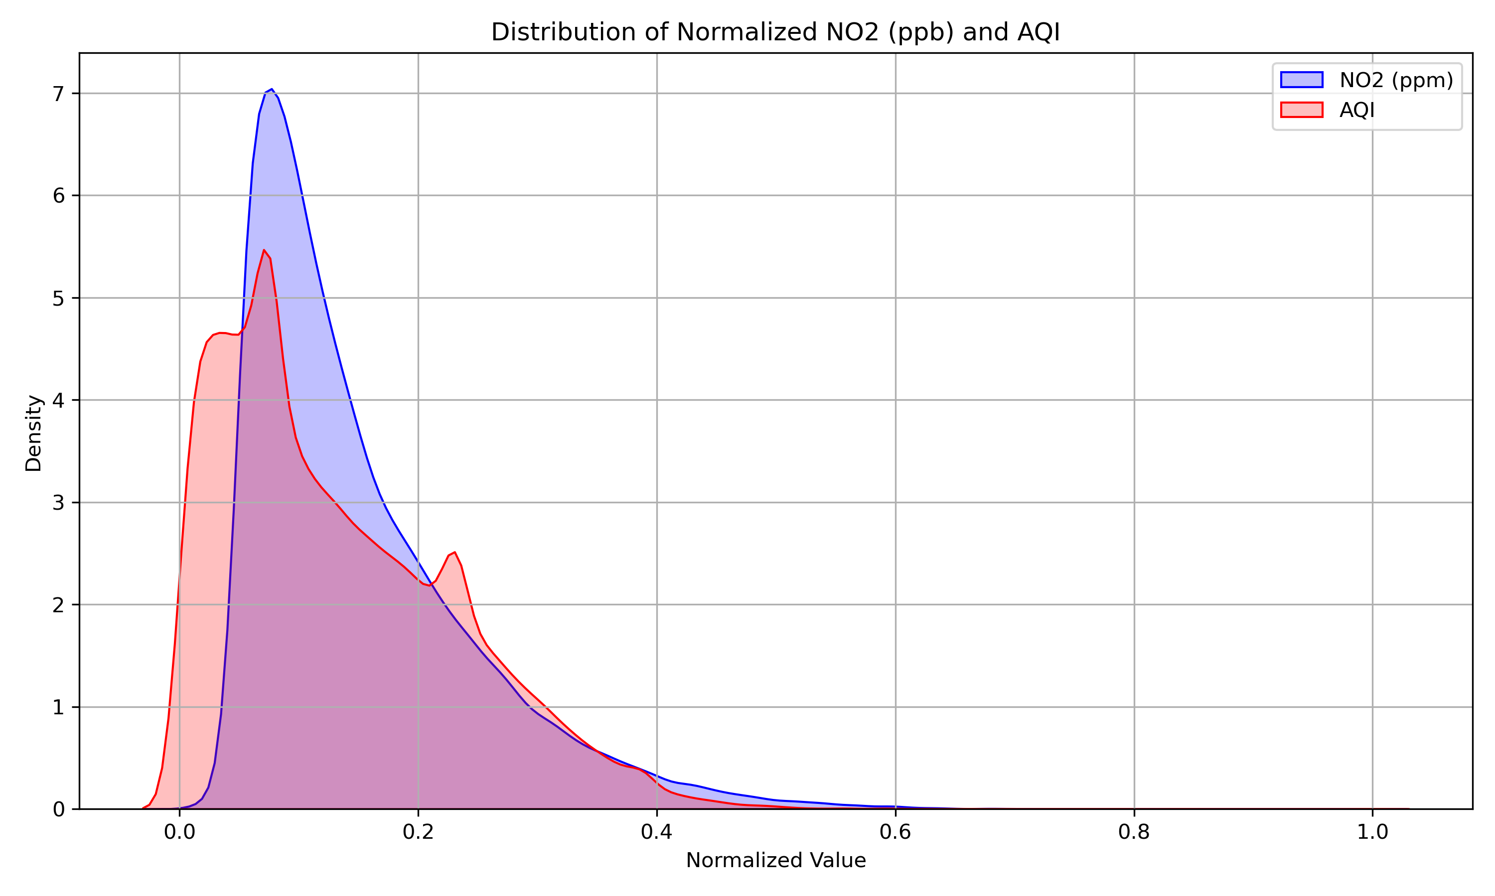
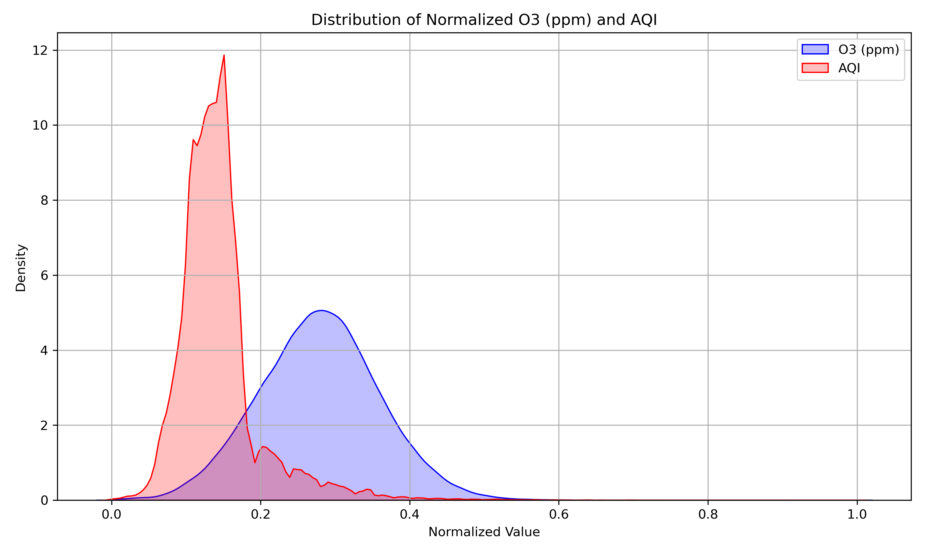
Normalized Values Distribution
Variance of values between chemical pollutant amounts and tied AQI

Slide 12

Conclusion
Chemical Gases have major impact on air quality
Small particulates have less impact but still make air quality severely reduced
US Cities have high air pollution, but comparatively lower than other foreign territories and countries

Slide 13
Thank you for your attention
Questions?

